Slide 1
NETWORKING FOR BEGINNERS
by Liubov Koliasa
IT Academy

Slide 2
NETWORKING AGENDA
Basics definition
OSI model
Network Access layer
Network layer
Transport layer
Application layer

Slide 3

Network
A computer network, or data network, is a digital telecommunications network which allows nodes to share resources and information. In computer networks, computing devices exchange data with each other using connections (data links) between nodes. These data links are established over cable media such as wires or optic cables, or wireless media such as WiFi.

Slide 4
Network Protocol
A network protocol defines rules and conventions for communication between network devices. Network protocols include mechanisms for devices to identify and make connections with each other, as well as formatting rules that specify how data is packaged into sent and received messages. Some protocols also support message ​acknowledgment and data compression designed for reliable and/or high-performance network communication.
Modern protocols for computer networking all generally use packet switching techniques to send and receive messages in the form of packets — messages subdivided into pieces that are collected and reassembled at their destination. Hundreds of different computer network protocols have been developed, each designed for specific purposes and environments.

Slide 5
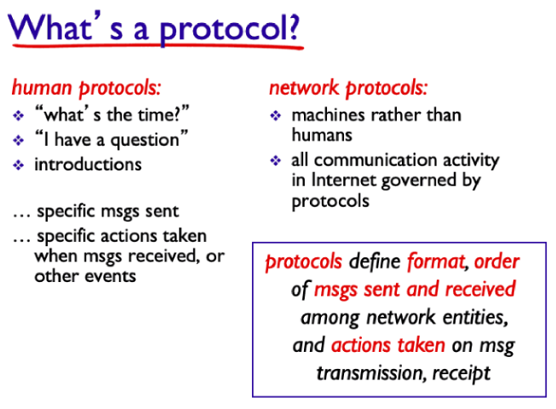

Slide 6
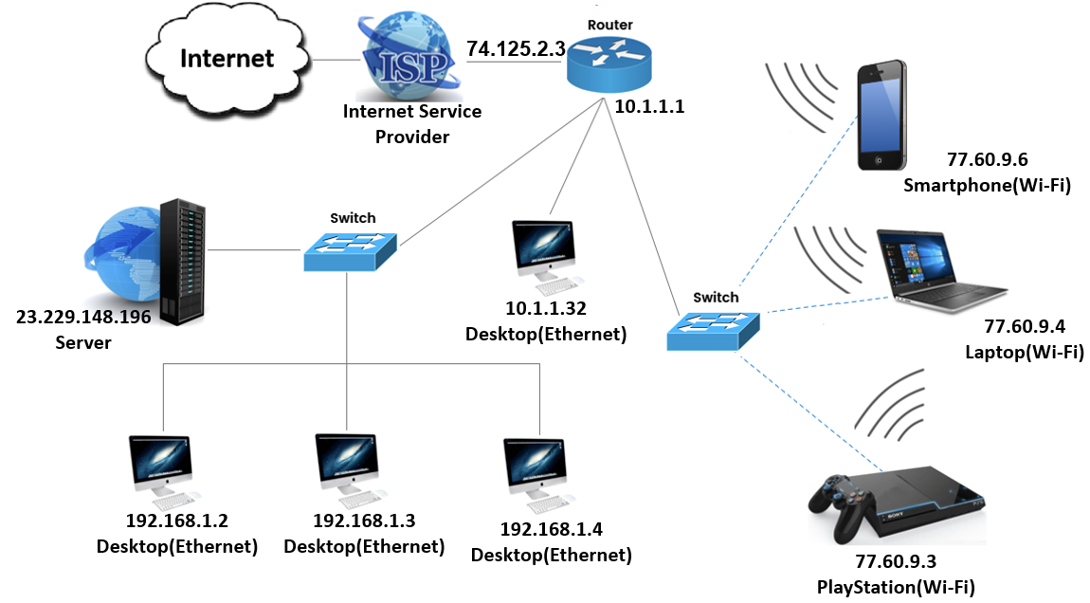
Network

Slide 7
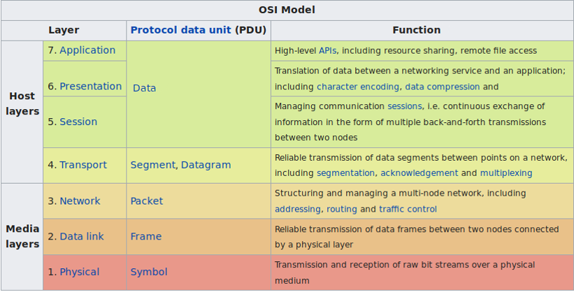
Open Systems Interconnection Model

Slide 8
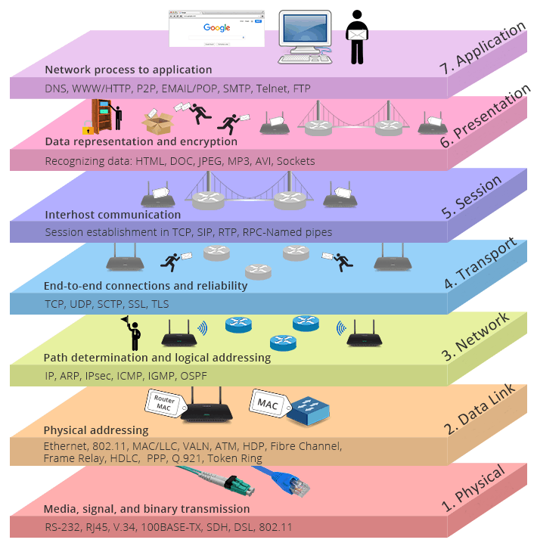
Open Systems Interconnection Model

Slide 9
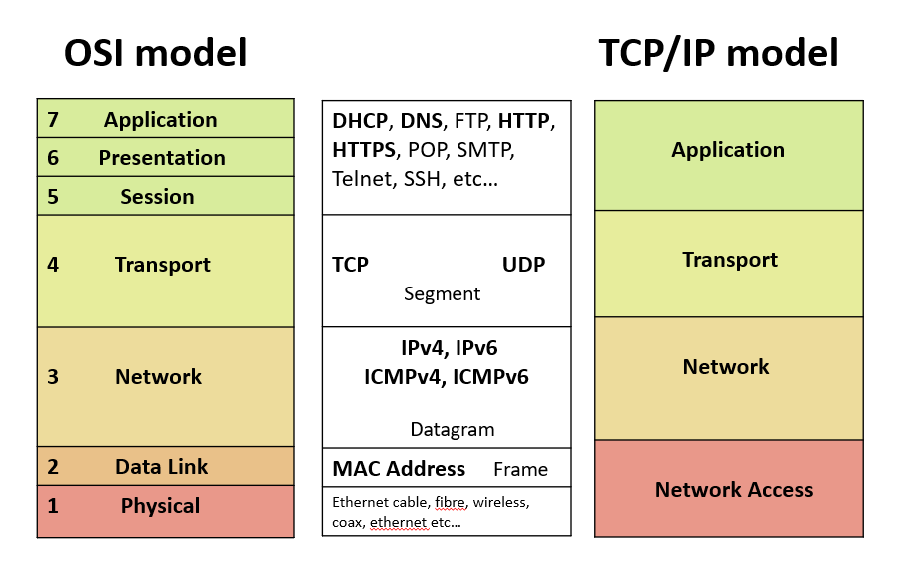

Slide 10
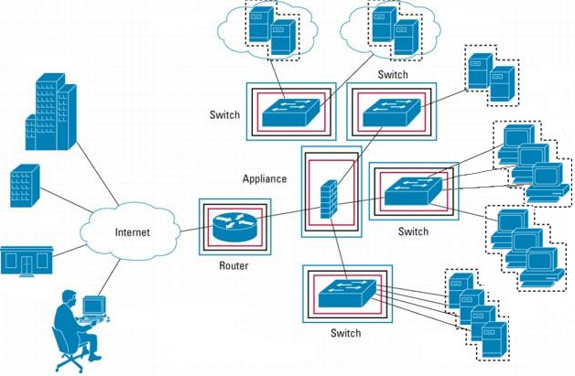
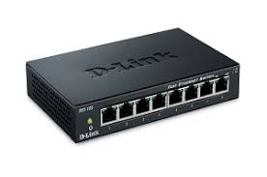
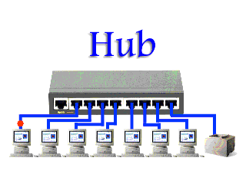
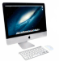
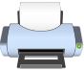
Basic hardware components
A hub joins multiple computers (or other network devices) together to form a single network segment.

Slide 11
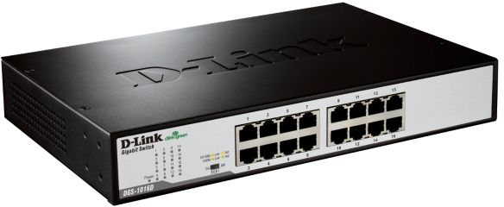
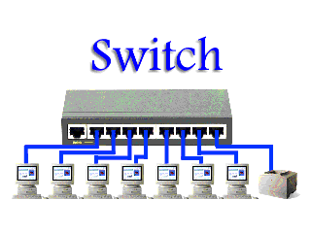
Basic hardware components
A switch is a network device with multiple ports in one network whose task is to copy frames from one port to another.
Notes:
Network adapters – PCI Adapters (Network Interface Cards), USB Adapters and Wireless Network Adapters

Slide 12
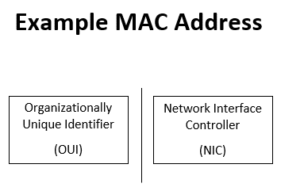
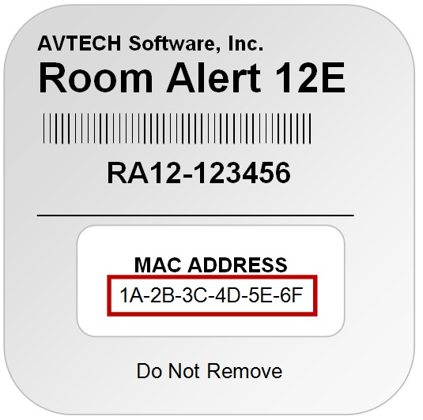
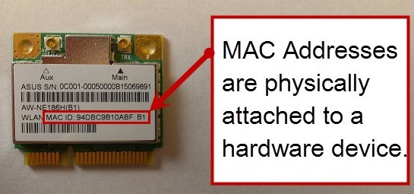
MAC address
A media access control address (MAC address) of a device is a unique identifier assigned to a network interface controller (NIC) for communications at the data link layer of a network segment. MAC addresses are used as a network address for most IEEE 802 network technologies, including Ethernet, Wi-Fi and Bluetooth.
1A:24:56:C4:68:B9

Slide 13
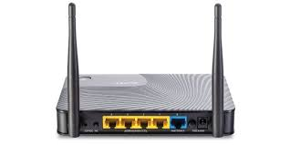

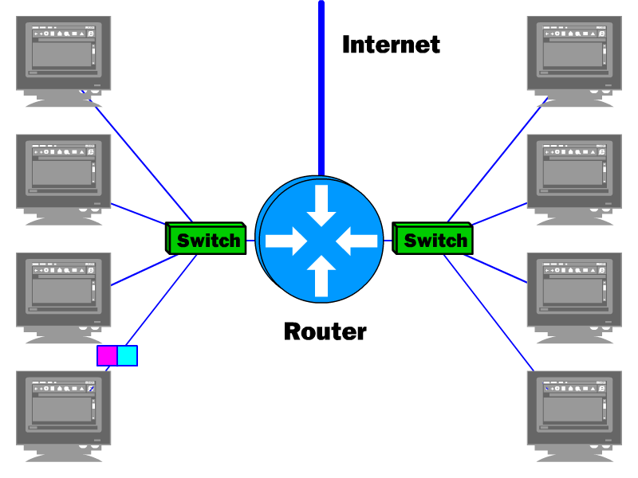
Basic hardware components
A router is a network device with interfaces in multiple networks whose task is to copy packets from one network to another.
Notes:
A router has two separate, but related, jobs:1 It ensures that information doesn't go where it's not needed. 2. It makes sure that information does make it to the intended destination

Slide 14
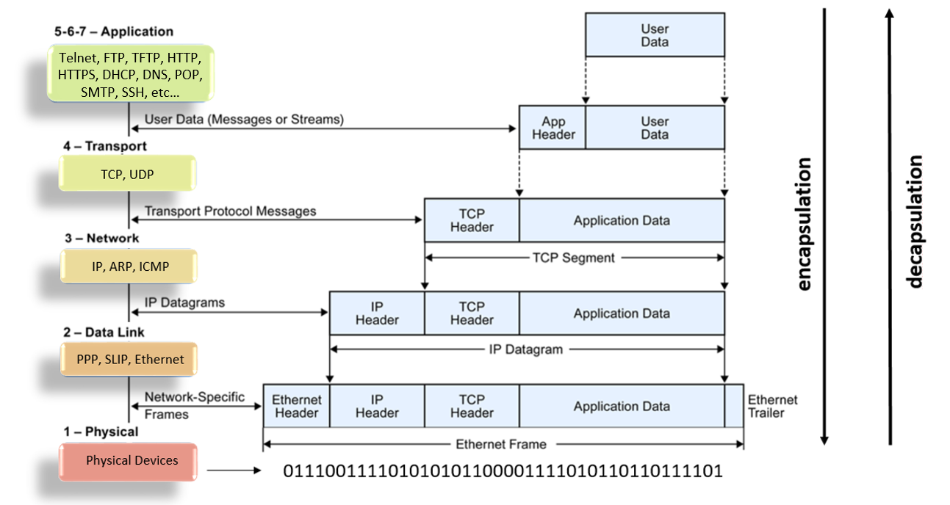
OSI model: IP Packet
Notes:
https://www.youtube.com/watch?v=PBWhzz_Gn10

Slide 15
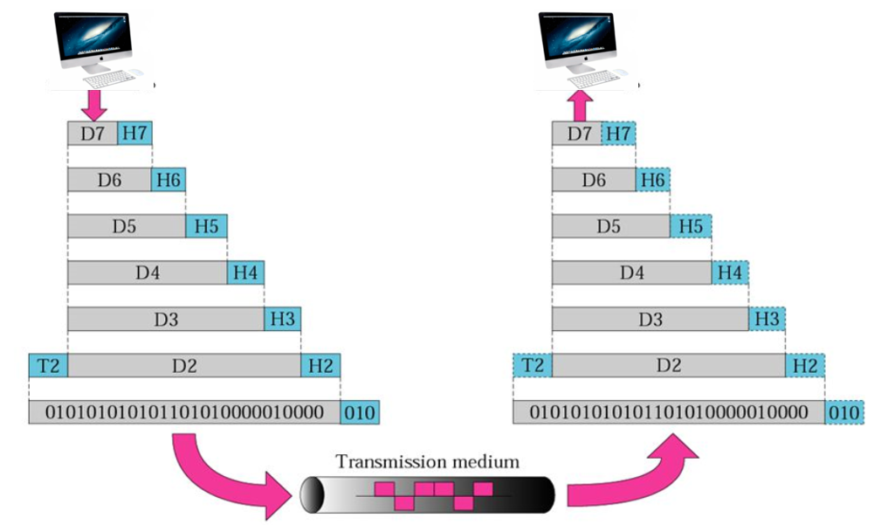
An exchange using the OSI model
Application layer
Presentation layer
Session layer
Transport layer
Network layer
Data link layer
Physical layer
encapsulation
decapsulation

Slide 16
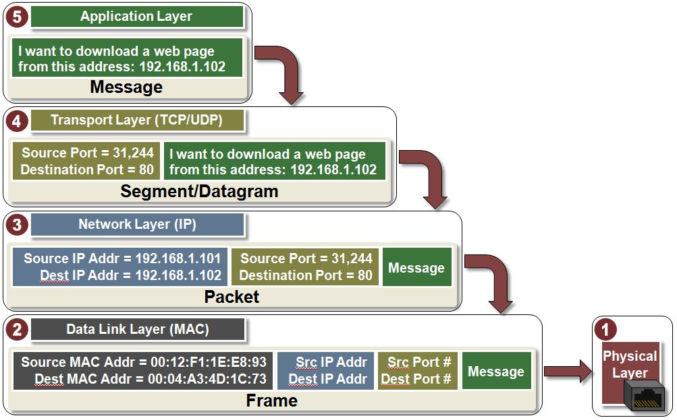
An exchange using the OSI model

Slide 17
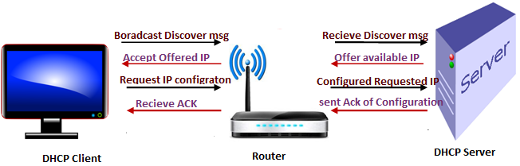
DHCP Server

Slide 18
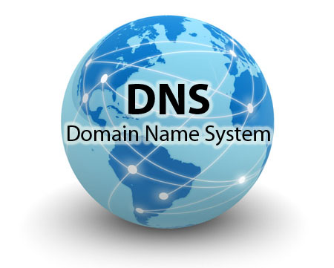

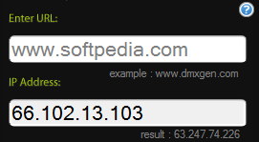
Domain Name System

Slide 19
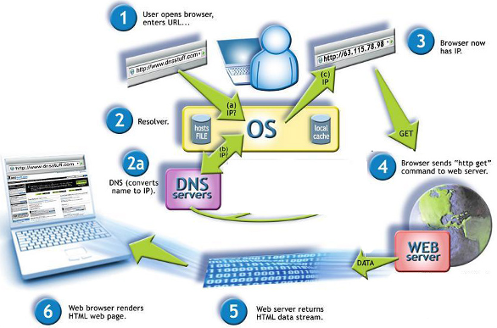

Slide 20
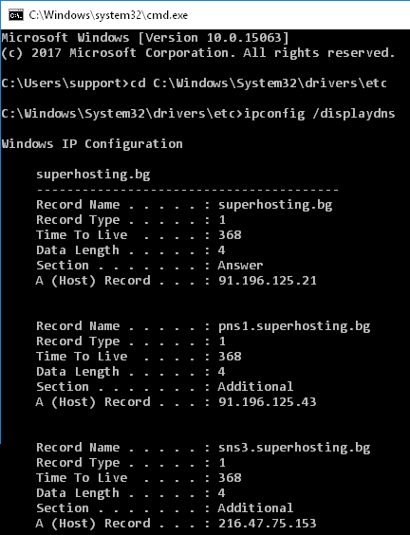
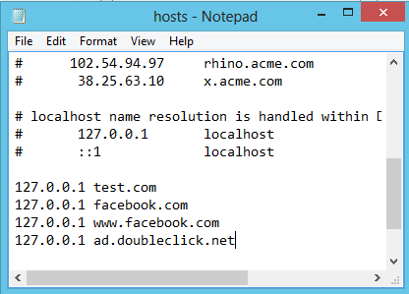
C:\Windows\System32\drivers\etc\hosts

Slide 21
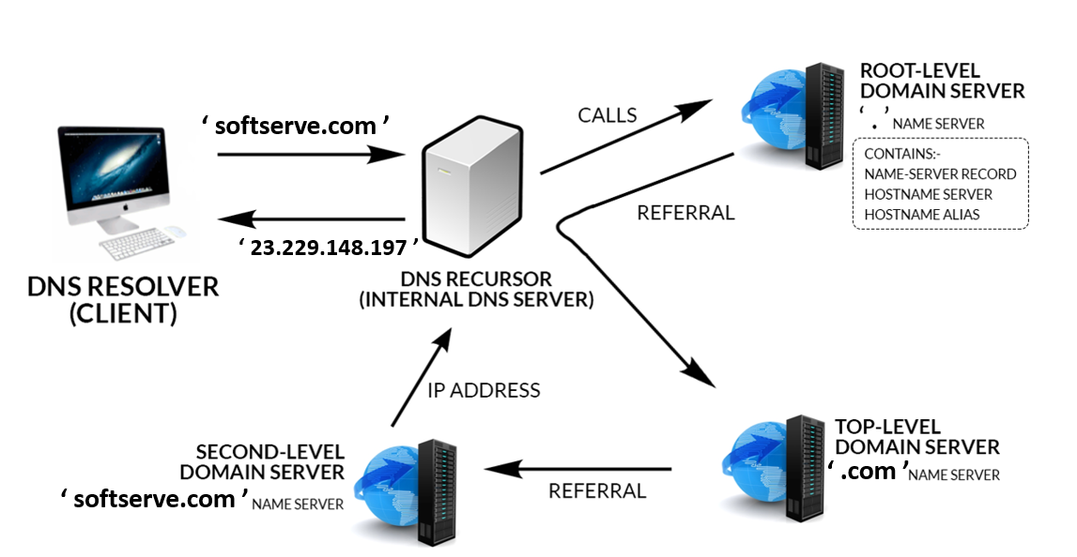
Domain Name System

Slide 22
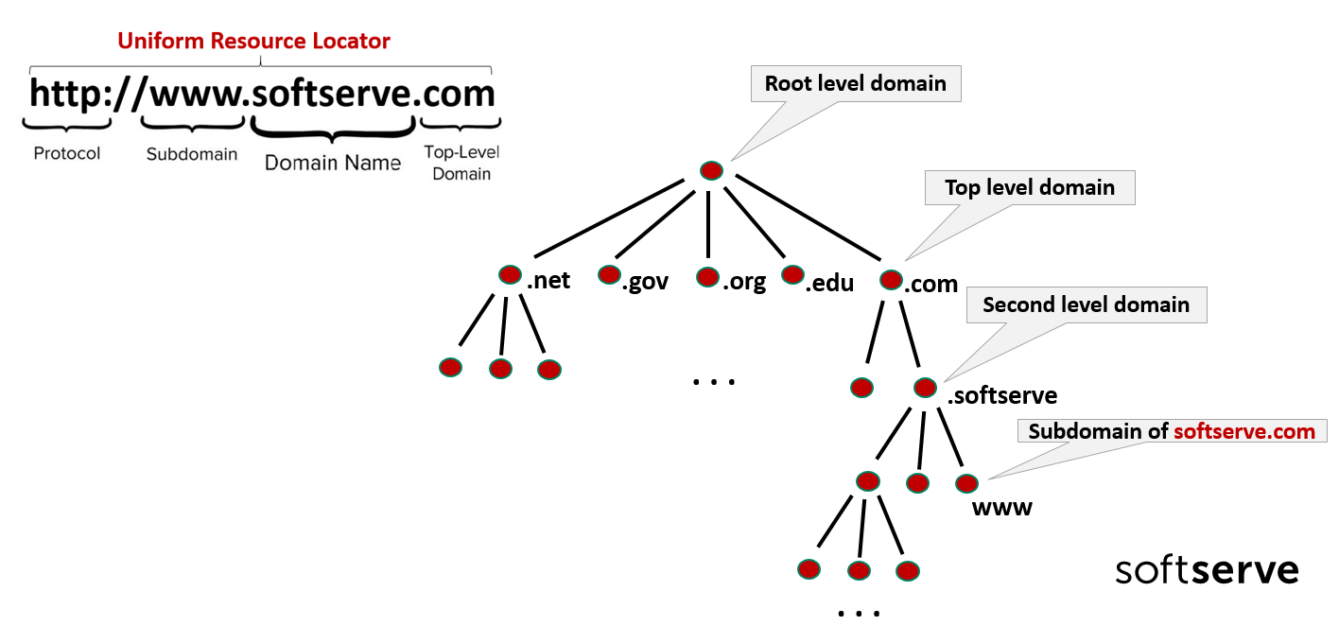
Hierarchy of domain names

Slide 23
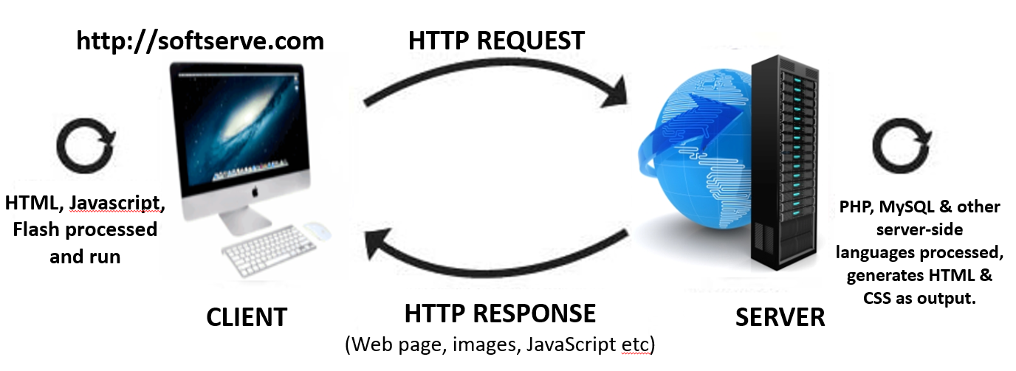
Application layer: Client-Server model
Web server (Web\ Application Servers, DB Servers, Mail Servers) and web client (web browsers) use Hypertext Transport Protocol (HTTP) to communicate. HTTP protocol determine the way web browser and web server to send message to each other and also determine structure of that message.
Characteristics of a Client:
Initiates requests
Waits for replies
Receives replies
Connects to a small number of servers at one time
Interacts directly with end-users using a GUI
Characteristics of a Server
Never initiates requests or activities
Waits for and replies to requests from connected clients
A server can remotely install/uninstall applications and transfer data to the intended clients

Slide 24
Application layer: Internet Protocols
TCP
HTTP, HTTPS, FTP, SMTP, Telnet
HTTP (port number 80) is Hypertext transfer protocol. Simply put - Rules to sending and receiving text-based messages.
HTTPS (port number 443) (Hyper Text Transfer Protocol Secure) is the secure version of HTTP, the protocol over which data is sent between your browser and the website that you are connected to.
FTP (port number 20 & 21) (File Transfer Protocol) is a standard network protocol used for the transfer of computer files between a client and server on a computer network.
SMTP (port number 25) (Simple Mail Transfer Protocol) is the standard protocol for email services on a TCP/IP network. SMTP provides the ability to send and receive email messages.

Slide 25
Application layer: Internet Protocols
UDP
DNS, DHCP, TFTP, SNMP, RIP, VOIP
DNS (Domain Name System) is a protocol which helps convert easy-to-understand domain names into an Internet Protocol (IP) address that computers use to identify each other on the network.
DHCP (Dynamic Host Configuration Protocol) is a protocol used to provide quick, automatic, and central management for the distribution of IP addresses within a network.
TFTP (Trivial File Transfer Protocol) is a network protocol used to transfer files between hosts in a TCP/IP network. It is a simpler version of FTP.
SNMP (Simple Network Management Protocol) is an Internet Standard protocol for collecting and organizing information about managed devices on IP networks and for modifying that information to change device behavior.

Slide 26
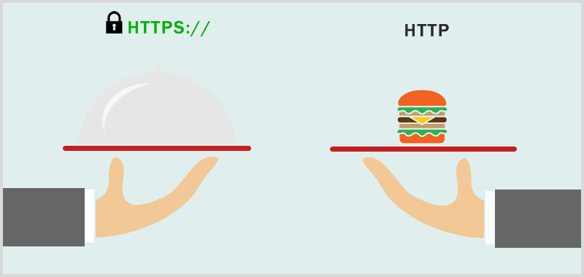
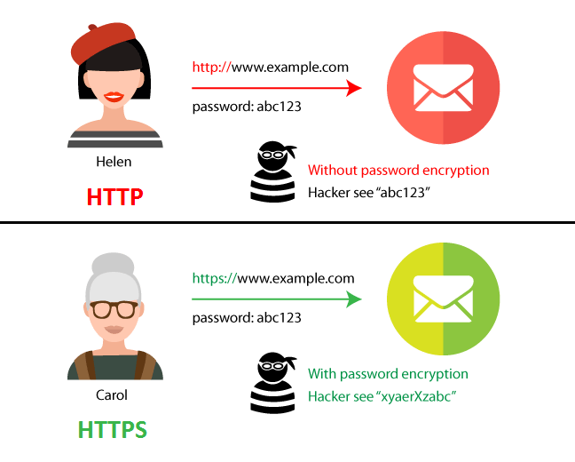
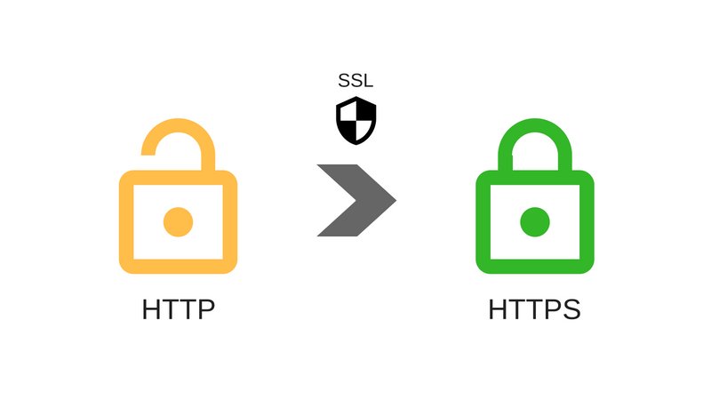
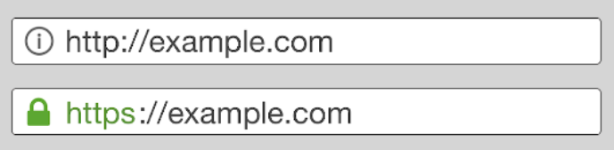
Http / Https
SSL (Secure Sockets Layer)

Slide 27
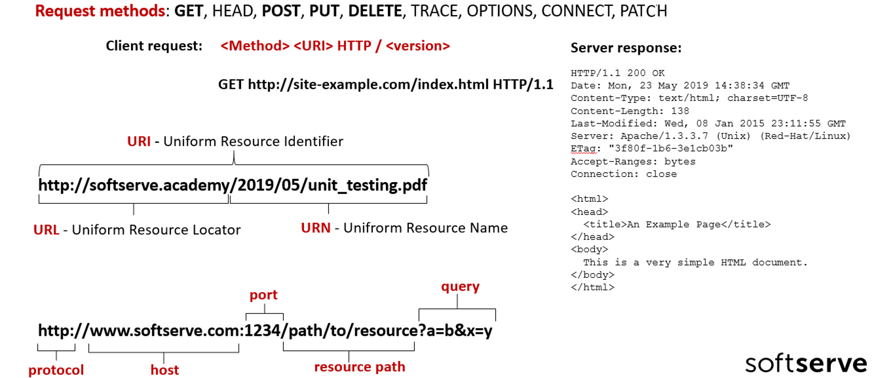
Application layer: HTTP methods

Slide 28
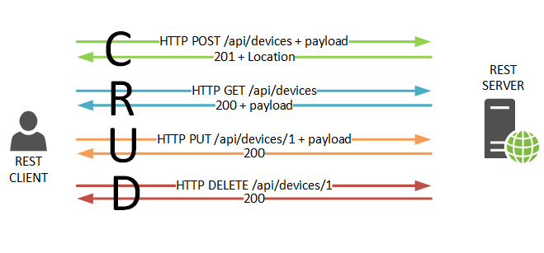
Application layer: HTTP methods

Slide 29
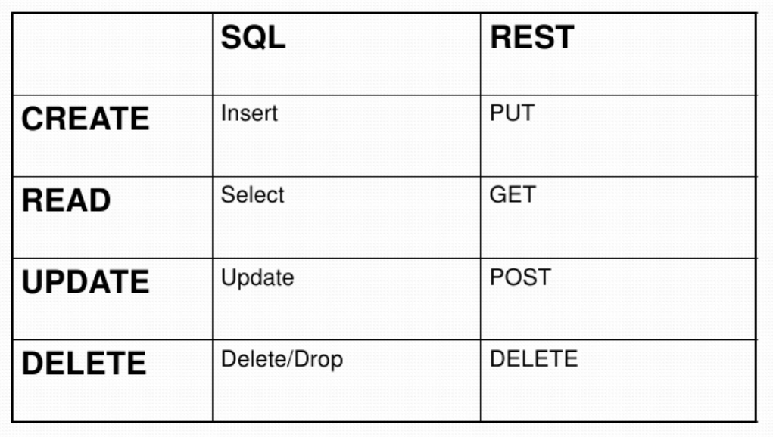
Application layer: HTTP methods

Slide 30
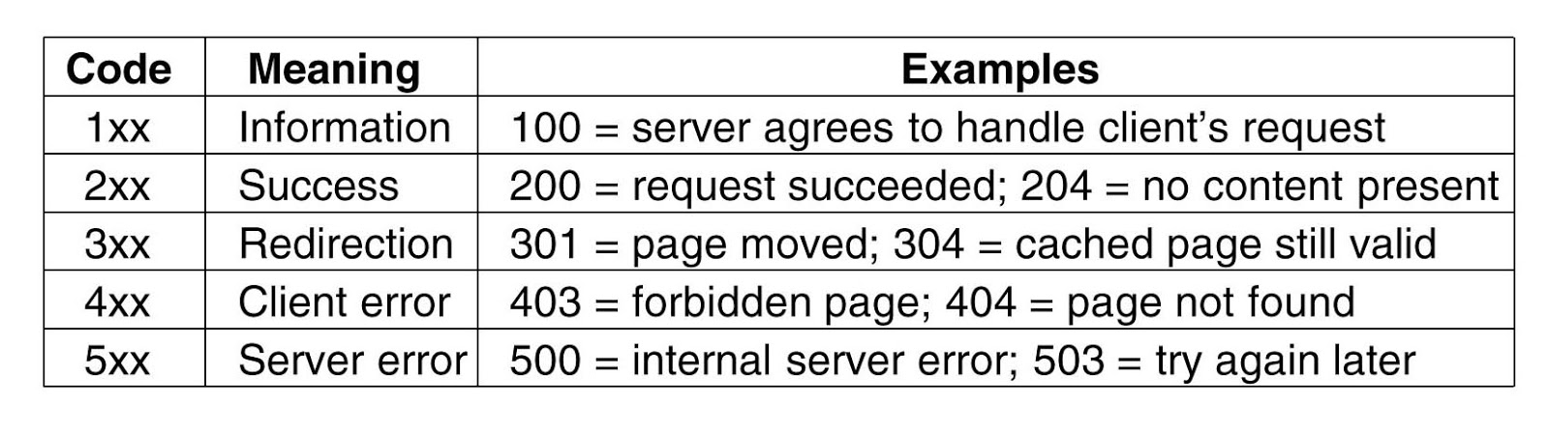
Application layer: HTTP response status codes

Slide 31
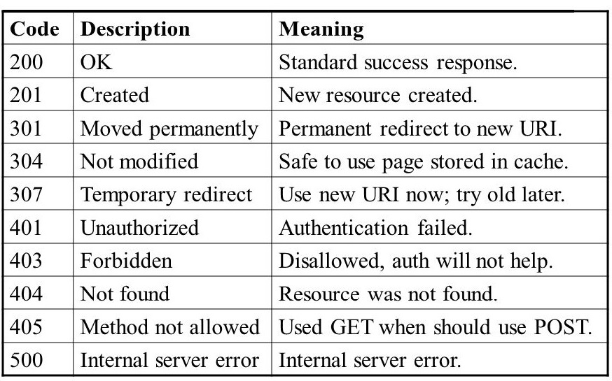
Application layer: HTTP response status codes

Slide 32
Transport layer: TCP and UDP Protocol
BASIS FOR COMPARISON | TRANSMISSION CONTROL PROTOCOL (TCP) | USER DATAGRAM PROTOCOL (UDP)
Meaning | TCP establishes connection between the computers before transmitting the data | UDP sends the data directly to the destination computer without checking whether the system is ready to receive or not
Connection Type | Guarantees delivery, connection oriented | Does not guarantee delivery, connection less
Order | Guarantee order of data in stream | Doesn’t guarantee order of packages
Speed | Slow | Fast
Reliability | Highly Reliable, control errors | Unreliable, doesn’t control errors
Header Size | 20 Bytes | 8 Bytes
Acknowledgement | It takes acknowledgement of data and has the ability to re transmit, if the user requests. | It neither takes acknowledgement nor it re transmits the lost data.
Used by | DNS, HTTP, HTTPS, FTP, SMTP and Telnet | DNS, DHCP, TFTP, SNMP, RIP, and VoIP

Slide 33
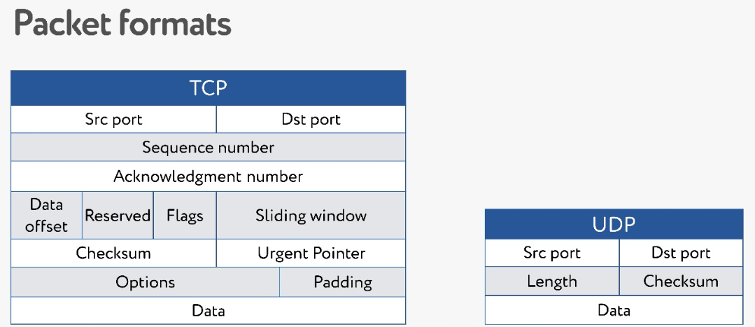
Transport layer: TCP and UDP Protocol

Slide 34
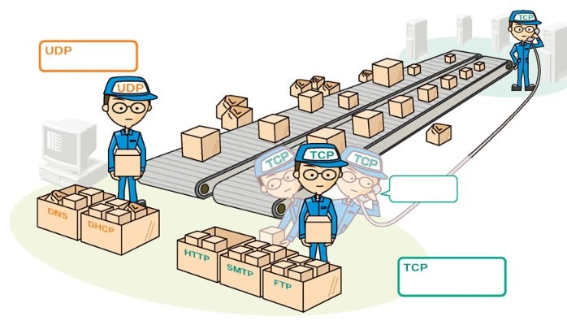
Transport layer: TCP and UDP Protocol
Protocol
Conection
Protocol

Slide 35
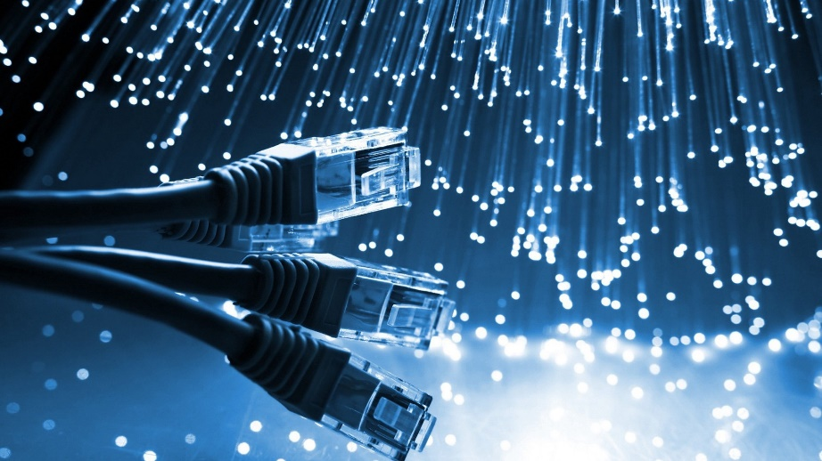
Transport layer: Network Ports
A network port is a process-specific or an application-specific software construct serving as a communication endpoint, which is used by the Transport Layer protocols of Internet Protocol suite, such as User Diagram Protocol (UDP) and Transmission Control Protocol (TCP).
A specific network port is identified by its number commonly referred to as port number, the IP address in which the port is associated with and the type of transport protocol used for the communication.
A port number is a 16-bit unsigned integer that ranges from 0 to 65535. Ports 0 to 1024 are reserved for use by certain privileged services. For the HTTP service, port 80 is defined as a default

Slide 36
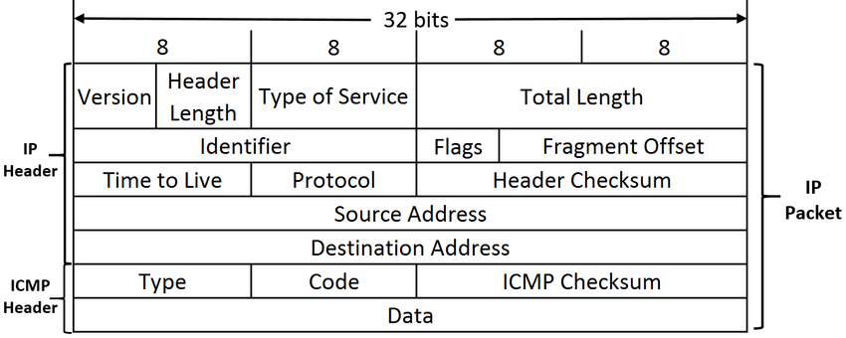
Network layer: IP address

Slide 37
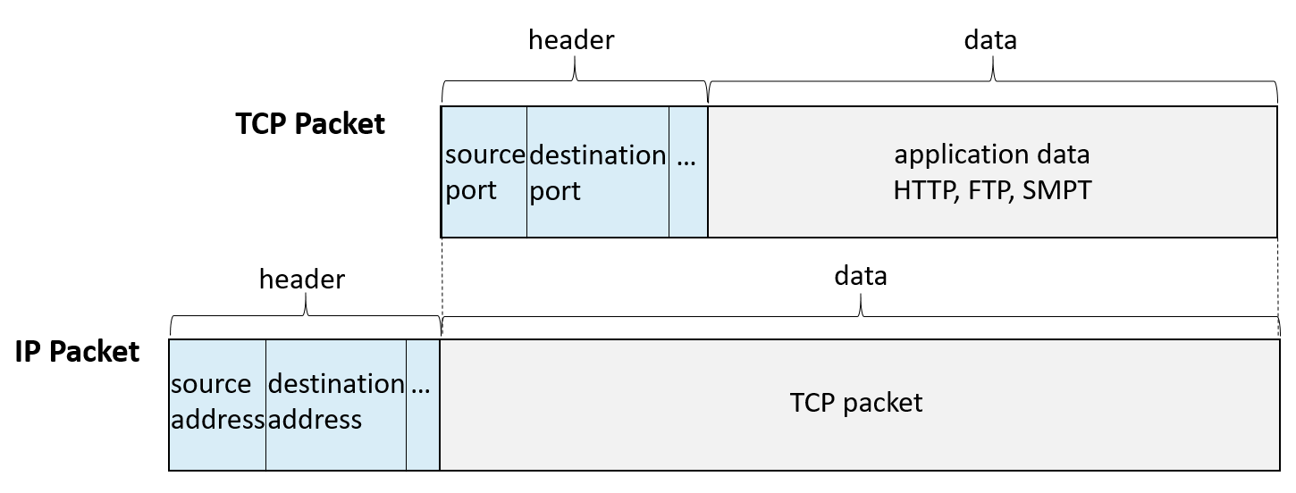
TCP/IP Packet

Slide 38
IP address v4 / v6
An Internet Protocol address (IP address) is a numerical label assigned to each device connected to a computer network that uses the Internet Protocol for communication. An IP address serves two principal functions: host or network interface identification and location addressing.
 | Internet Protocol version 4 (IPv4) | Internet Protocol version 6 (IPv6)
Deployed | 1981 | 1999
Address Size | 32-bit number | 128-bit number
Address Format | Dotted Decimal Notation: 192.149.252.76 | Hexadecimal Notation: 3FFE:F200:0234:AB00: 0123:4567:8901:ABCD
Profix Notation | 192.149.0.0/24 | 3FFE:F200:0234::/48
Number of Addresses | 2³² ~ 4 294 967 296 | 2¹²⁸ ~ 340 282 366 920 938 463 374 607 431 768 211 456

Slide 39
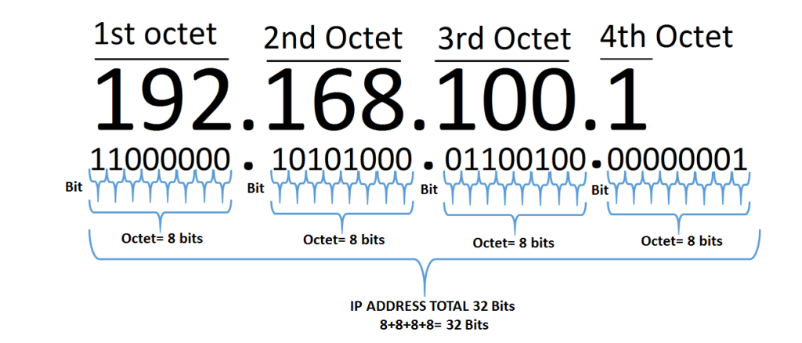
IP address v4

Slide 40
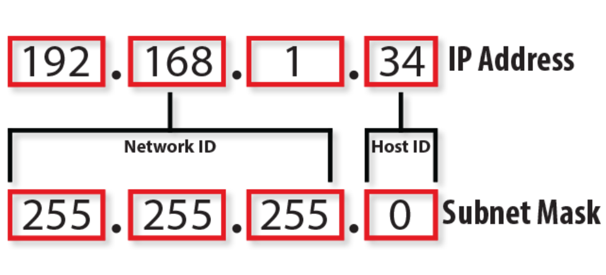
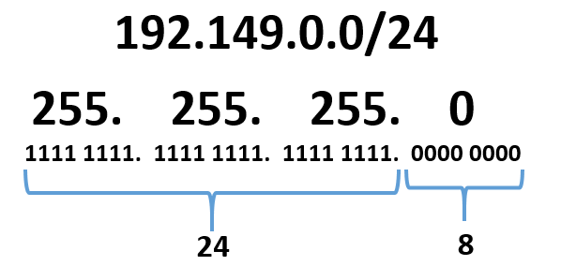
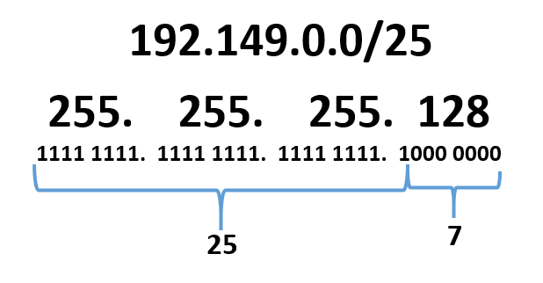
IP address: Subnet mask
192.149.0.1 - 192.149.0.254
192.149.0.255 broadcast
192.149.0.1 - 192.149.0.127
192.149.0.128 broadcast

Slide 41
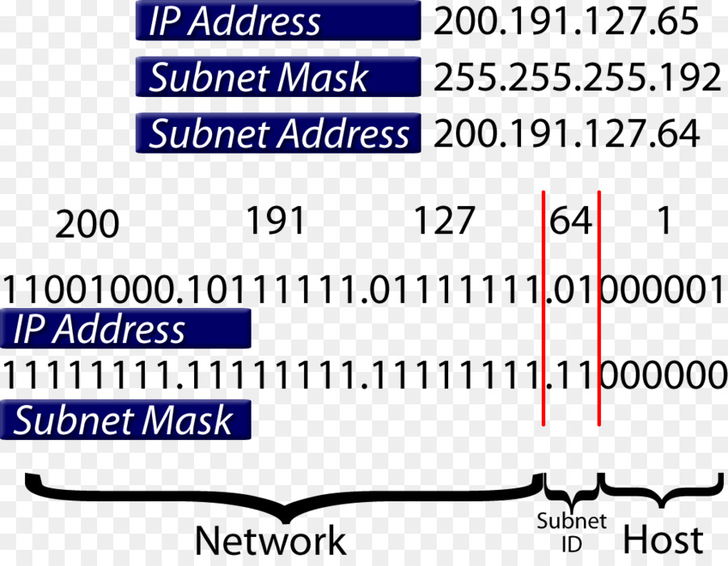
IP address: Subnet mask

Slide 42
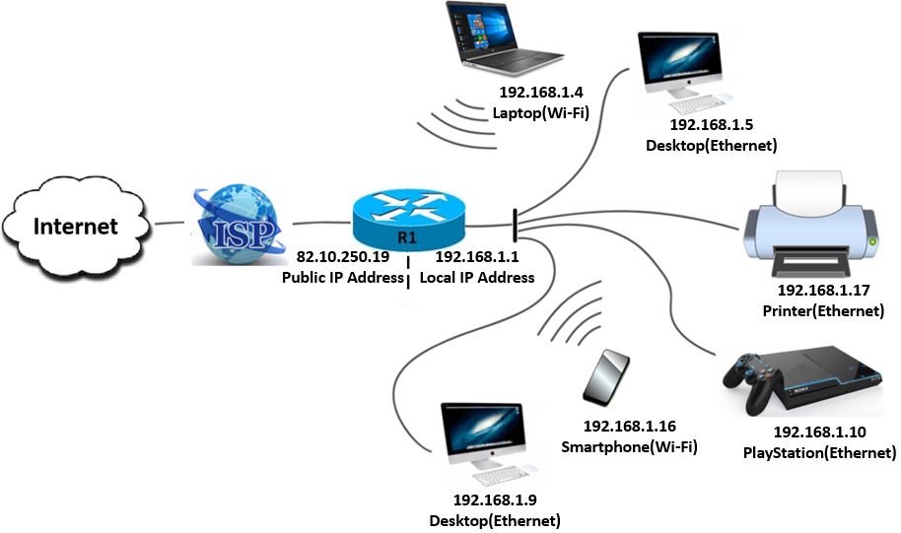
IP address: External and Internal
External and internal IP addresses both serve the same purpose, the difference is scope.
An external or public IP address is used across the entire Internet to locate computer systems and devices.
A internal or local IP address is used inside a private network to locate the computers and devices connected to it.
Router
IP Address: 192.168.1.6
Subnetwork: 255.255.255.0
Default gateway: 192.168.1.1

Slide 43
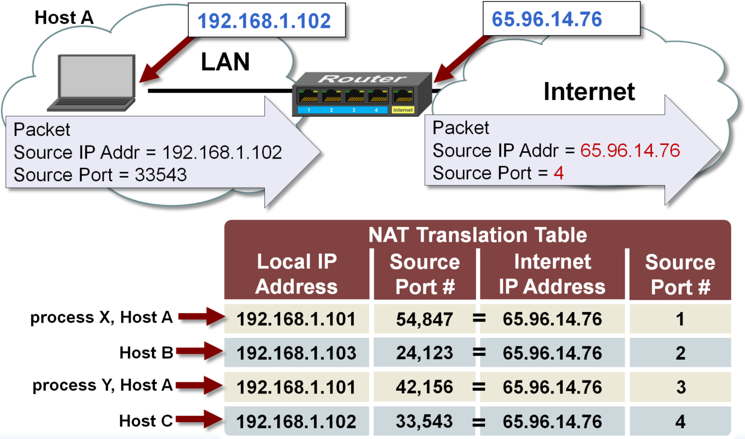
Network Address Translation

Slide 44

IP address: Static and Dynamic
A static IP address is the address your ISP (Internet Service Provider) provides you with. No matter what you do – reboot the system, restart the router/modem – it will stay the same.
A dynamic IP address is more flexible. Yes, it can still be assigned by the ISP. However, a single system or router/modem reset is usually enough to change it. Sometimes, the address might even change when you’re connected to the web.

Slide 45

Physical and Data Link layers

Slide 46

Address Resolution Protocol
Broadcast MAC address ff:ff:ff:ff:ff:ff

Slide 47

ARP PROTOCOL
Broadcast MAC address ff:ff:ff:ff:ff:ff
Internet Address | Physical Address | Type
192.168.0.1 | c4-e9-84-e5-be-54 | dynamic
192.168.0.100 | 70-af-24-0e-c0-63 | dynamic
224.0.0.22 | 01-00-5e-00-00-16 | static
224.0.0.251 | 01-00-5e-00-00-fb | static
224.0.0.252 | 01-00-5e-00-00-fc | static
239.255.255.250 | 01-00-5e-7f-ff-fa | static
255.255.255.255 | ff-ff-ff-ff-ff-ff | static

Slide 48

Physical layers

Slide 49

Proxy Server

Slide 50


Proxy Server

Slide 51


VPN

Slide 52

VPN

Slide 53


Difference between Proxy Server & VPN

Slide 54

Difference between Proxy Server & VPN

Slide 55

Difference between Proxy Server & VPN

Slide 56
THANK YOU FOR ATTENTION

